Slide 1
Scalable Data Analytics
SENG 550
AKA. Big Data - Data Engineering
Armin Zirak

Slide 2
Kimball Data Modeling
5

Slide 3
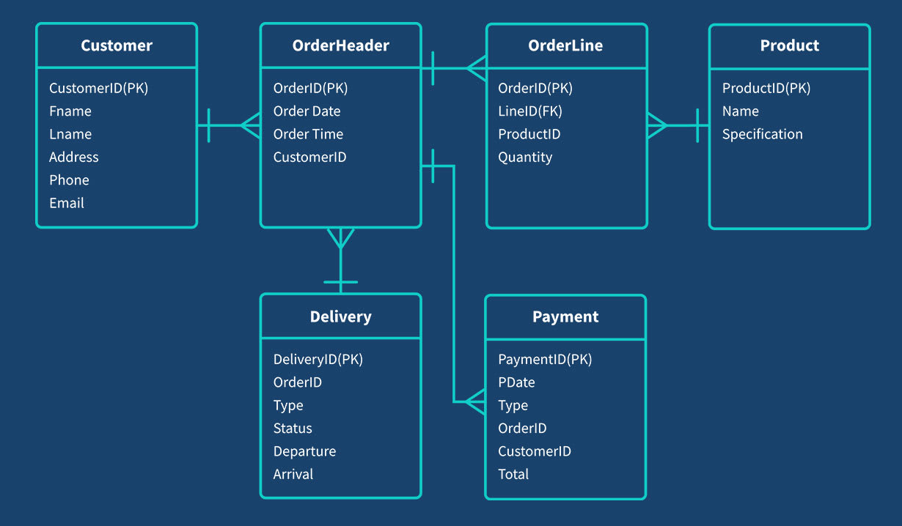
Data Modeling
Data modeling in relational databases is the process of organizing data elements and their relationships into structured tables to reduce redundancy, ensure data integrity, and support efficient querying.

Slide 4
Example
Imagine you have the below customers with their associated addresses.
id | name | address
1 | Armin | 1 - 123, 4th street, SW, Calgary, AB, Canada, T3V 4X1
2 | Rafiee | 2 - 456, 7th street, SW, Calgary, AB, Canada, T4V 4X2
…

Slide 5
Example (Continued)
What if you store them in this format?
Address field that could be a plain text or a json object is now separated into a list of columns.
id | name | street number | unit number | street | city | area | province | country | postal code
1 | Armin | 123 | 1 | 4th | Calgary | SW | AB | Canada | T3V 4X1
2 | Rafiee | 456 | 2 | 7th | Calgary | SW | AB | Canada | T4V 4X2

Slide 6
Example (Continued)
What if you store them in this format?
We can query specific fields -> select count(‘*’) from customers where city = ‘Calgary’
We can leverage database indexes to make queries more efficient.
Data looks more structured now.
But, there could be less flexibility now…
id | name | street number | unit number | street | city | area | province | country | postal code
1 | Armin | 123 | 1 | 4th | Calgary | SW | AB | Canada | T3V 4X1
2 | Sarah | 456 | 2 | 7th | Calgary | SW | AB | Canada | T4V 4X2

Slide 7
Example (Continued)
What if we use a separate table for cities?
city_id references the corresponding city.
id | city | province | Country
1 | Calgary | AB | Canada
id | name | street number | unit number | street | city_id | Area | Full Address | Postal Code
1 | Armin | 123 | 1 | 4th | 1 | SW | 1 - 123, 4th street | T4V 4X2
2 | Sarah | 456 | 2 | 7th | 1 | SW | 2 - 456, 7th street, | T4V 4X2

Slide 8
Example (Continued)
Storage will be used more efficiently.
Calgary, AB and Canada don’t have to be repeated for every single customer. Only one reference to cities table is enough.
But storage is not a huge deal these days.
Updates will become faster.
If a city moves from a province to another one, only one row needs change.
id | city | province | Country
1 | Calgary | AB | Canada
id | name | street number | unit number | street | city_id | Full Address | Postal Code
1 | Armin | 123 | 1 | 4th | 1 | 1 - 123, 4th street | T4V 4X2
2 | Sarah | 456 | 2 | 7th | 1 | 2 - 456, 7th street, | T4V 4X2

Slide 9
Example (Continued)
Removing redundancies increases consistency.
You wouldn’t see some rows reference to Calgary in AB while others reference to Calgary in a new province.
Adding a new row to customers could be faster because you wouldn’t need to insert the full information
id | city | area | province | Country
1 | Calgary | SW | AB | Canada
id | name | street number | unit number | street | city_id | Full Address | Postal Code
1 | Armin | 123 | 1 | 4th | 1 | 1 - 123, 4th street | T4V 4X2
2 | Sarah | 456 | 2 | 7th | 1 | 2 - 456, 7th street, | T4V 4X2

Slide 10
Example (Continued)
Efficiency of read queries that need information from both tables would be less.
A query that retrieves full user information
select * from customers left join cities where customer.city_id = cities.id;
id | city | area | province | Country
1 | Calgary | SW | AB | Canada
id | name | street number | unit number | street | city_id | Full Address | Postal Code
1 | Armin | 123 | 1 | 4th | 1 | 1 - 123, 4th street | T4V 4X2
2 | Sarah | 456 | 2 | 7th | 1 | 2 - 456, 7th street, | T4V 4X2

Slide 11
Normalization
Normalization is the process of organizing data in a relational database to minimize redundancy and ensure data integrity by dividing large tables into smaller, related tables and defining relationships between them.
Normalization
Eliminates duplicate data
Reduces data anomalies (insertion, update, deletion)
Ensures logical data structure
Improves data consistency and maintainability

Slide 12
Normalization - Forms
Normalization is done in stages called normal forms:
1NF – No repeating groups; all values are atomic.
2NF – No partial dependencies; every non-key depends on the whole primary key
3NF – No transitive dependencies; non-key attributes depend only on the primary key
4NF, BCNF, …
This slide won’t be questioned in the exam.

Slide 13
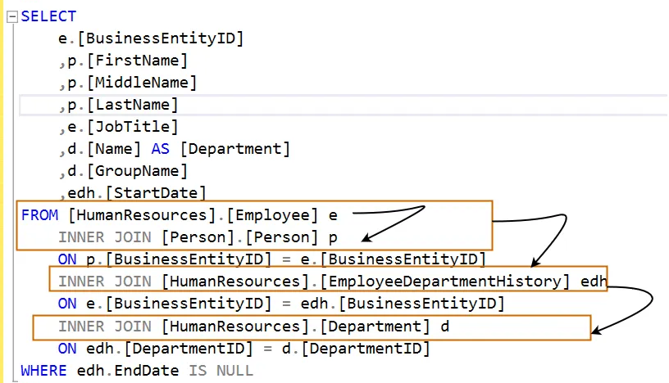
Highly Normalized Table Example
A table of orders, each order is associated to a customer, product, payment method, delivery, discount, etc
A lot of joins…
Customers
Products
id | name | phone | address | …
1 | Armin | 123 | 123, 4th street …
2 | Sarah | 456 | 123, 5th street …
id | price | Category | …
1 | 450 | Laptop
2 | 700 | Cell Phone
id | amount | Processor | …
1 | 450 | Mastercard
2 | 700 | Visa
id | customer_id | product_id | payment_id | …
1 | 1 | 1 | 1
2 | 2 | 2 | 2
Payments
Orders

Slide 14
Denormalization
Denormalization: Intentionally introducing redundancy into a database by combining normalized tables. (Opposite of Normalization)
Store data in wide tables to avoid extra joins.
For example, a single orders table stores everything. Customer and product information are repeated at each row which is a lot of data redundancy.
Queries are run on a single table.
id | customer_name | customer_phone_number | customer_address | …. | product_id | product_price | …
1 | Armin | 123 | 123, 4 th street … |  | 1 | 450
2 | Rafiee | 456 | 123, 5 th street … |  | 2 | 700

Slide 15
Denormalization
The read queries that need a combination of information between product, order and customer perform better.
Also, require less domain knowledge to find your data.
Easier for less technical stakeholders (e.g., data analysts)
id | customer_name | customer_phone_number | customer_address | …. | product_id | product_price | …
1 | Armin | 123 | 123, 4 th street … |  | 1 | 4th
2 | Rafiee | 456 | 123, 5 th street … |  | 2 | 7th

Slide 16
Normalization vs Denormalization
Aspects | Normalization | Denormalization
Redundancy | Less | More
Integrity (Accuracy) | Higher | Lower
Storage Efficiency | Higher | Lower
Read Performance | Less (More Joins) | More
Write Performance | Higher | Lower
Maintenance | Easier | Harder (Duplicated Data)
Data Storage* | Transactional Databases | Analytical Data Warehouses
Use Case * | OLTP - Software | OLAP - Analytics
Will cover later

Slide 17
Data Modeling
Finding the right balance between highly normalized and highly denormalized data structures is a key part of effective data modeling.
Data Modelling is not just finding the proper normalization level. It includes a broader concept of finding the logical and physical entities.
Identify key entities like Customer, Order, and Product.
Define relationships such as one-to-many between Customer and Orders.
Choose primary keys and foreign keys for unique identification and links.
Set constraints like non-null fields and valid data ranges.
Design indexes to improve query performance.
Plan for scalability using partitioning or sharding (will cover later in distributed databases)
Enforce data integrity with referential constraints and cascading actions.

Slide 18
Data Modeling in Analytics
Best data models in analytics zone:
Often uses denormalized tables for faster reads
Focuses on joins, aggregations, summaries
Deals with historical data management.
Supports complex queries and multidimensional analysis
Prioritizes query performance over write efficiency
Common Models for Analytics Zone Data Modelling
Star Schema
Snowflake Schema
Data Vault

Slide 19
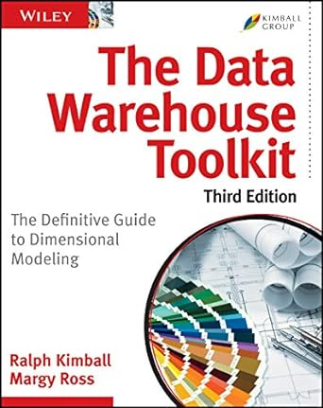
Kimball Data Modeling
Ralph Kimball is one of the founding architects of data warehousing and dimensional modeling.
Kimball’s Approach emphasizes building data marts (small, subject-specific data warehouses) and integrating them into a data warehouse using a bottom-up approach.

Slide 20
Dimensional Modeling
Kimball uses dimensional modeling, which organizes data into fact and dimension tables.
Fact tables store quantitative data such as sales, cost, quantity
Eg., Orders, Payments, Deliveries
Increasing in size forever and append-only.
Dimensional tables store descriptive information such as customer name and product information.
E.g., Customers, Locations, Products
Smaller than fact tables. Not inserting data frequently.
Fact tables contain foreign keys that refer to dimensional tables.
Can be Implemented in two common formats known as Star and Snowflake schema

Slide 21
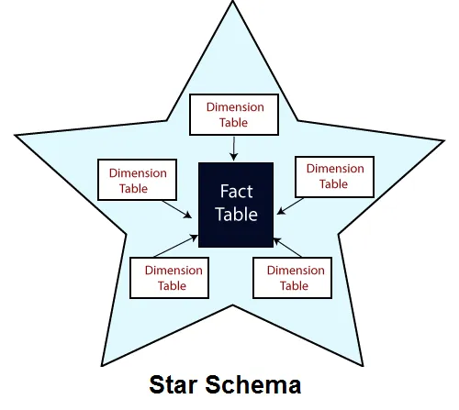
Star Schema
There is one central fact surrounded by multiple dimension tables.
Dimension tables are not connected to each other
Simple and easy to understand by non-technical business users
Users query fact tables and pull in other information they need from dimension tables.

Slide 22
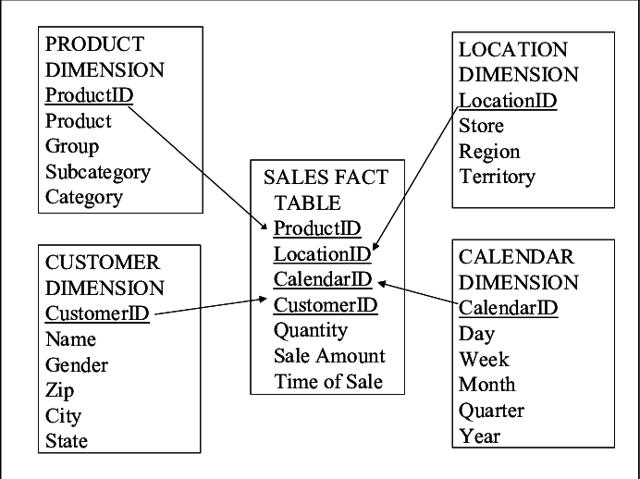
Star Schema

Slide 23
Star Schema - Sample Analysis Query
SELECT
sum(f.sales_amount),
sum(f.quantity),
sum(f.discount)
FROM
fact_sales f
JOIN
dim_customer c ON f.customer_id = c.customer_id
JOIN
dim_product p ON f.product_id = p.product_id;
WHERE c.city = ‘Calgary’ AND p.category = ‘Technology’

Slide 24
Star Schema - Sample Analysis Query 2
SELECT
p.patient_name,
d.diagnosis_description,
f.total_cost,
t.treatment_date
FROM
fact_treatment f
JOIN
dim_patient p ON f.patient_id = p.patient_id
JOIN
dim_diagnosis d ON f.diagnosis_id = d.diagnosis_id
JOIN
dim_time t ON f.time_id = t.time_id
WHERE
t.treatment_date BETWEEN '2023-01-01' AND '2023-12-31';
Fact tables are narrow that potentially offers optimization benefits depending on database (data warehouse) engine.

Slide 25
Star Schema - Dimension Tables
Dimensions are often denormalized.
Products have categories, Customers have addresses, etc
But, they are not separated in other tables, they are stored within the same dimensional table.
Denormalization at dimension tables makes
Data more understandable by non-technical business users
Joins more efficient as they involve less number of table
Design easier for data engineers.
A lot of data redundancy

Slide 26
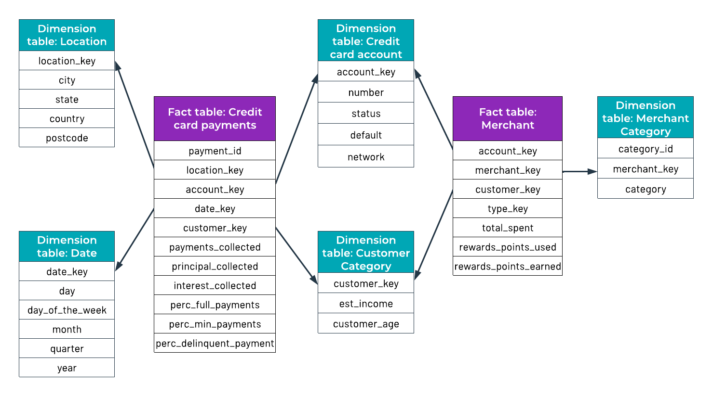
Galaxy Schema
Often multiple starts are needed, each one representing a business aspect
When there is multiple start and they share some dimensions, it’s called Galaxy schema
Galaxy is just an extension of Star schema

Slide 27
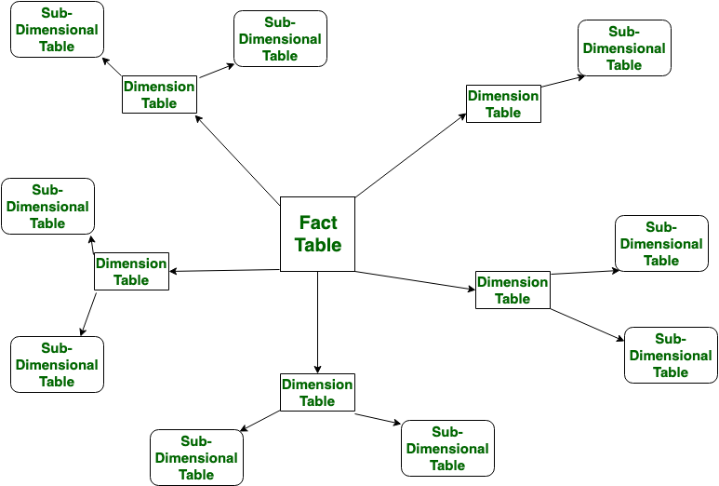
Snowflake Schema
More normalized version of star schema.
Dimensions have sub dimensions
For example, product categories might be a sub dimensional table for products
More storage efficiency
Less reader performance
Because it involves more joins
Harder to understand by non-technical users

Slide 28
Data Updates
Factual tables are usually append only (Immutable)
E.g., new orders, payments
Dimension tables can change.
E.g., The name of the food name. Color of a product changes.
These are called changing dimensions or slowly changing dimensions (SCD).

Slide 29
Star Schema - Changing Dimensions
There is different types to update dimension tables.
Type 1, 2, 3, 4, etc (This is a new very important data modelling concept)
Consider the data below…
fact_orders
order_id | customer_id | date | …
1 | 1 | 2024-01-01
2 | 1 | 2024-05-01
3 | 2 | 2024-09-01
4 | 1 | 2024-12-01
…
dim_customers
customer_id | city | …
1 | Calgary
2 | Vancouver
…

Slide 30
Dimension Tracking - Type 1
What happens if a customer moves to Toronto from Calgary?
Type 1 simply overwrites the existing values.
What could be the problem with this update?
fact_orders
order_id | customer_id | date | …
1 | 1 | 2024-01-01
2 | 1 | 2024-05-01
3 | 2 | 2024-09-01
4 | 1 | 2024-12-01
…
dim_customers
customer_id | city | …
1 | Calgary
2 | Vancouver
…
Toronto

Slide 31
Dimension Tracking - Type 1
Type 1 overwrites the values so it doesn’t preserve the history.
In analytics use cases (data science, data analysis), it’s quite important to track history.
select sum(amount)
from fact_orders o
left join dim_customers c
on c.customer_id = o.customer_id
where c.city = ‘Calgary’;
fact_orders
order_id | customer_id | date | …
1 | 1 | 2024-01-01
2 | 1 | 2024-05-01
3 | 2 | 2024-09-01
4 | 1 | 2024-12-01
…
dim_customers
customer_id | city | …
1 | Calgary
2 | Vancouver
…
Toronto

Slide 32
Dimension Tracking - Type 2
Type 2 adds a new row for each change.
start_date and end_date enable matching data points
1900-01-01 represents the beginning of history, 9999-12-01 represents the end of it.
fact_orders
dim_customers
order_id | customer_id | date | …
1 | 1 | 2024-01-01
2 | 1 | 2024-05-01
3 | 2 | 2024-09-01
4 | 1 | 2024-12-01
…
customer_id | city | start_end | end_date | …
1 | Calgary | 1900-01-01 | 2024-08-01
1 | Toronto | 2024-08-01 | 9999-12-01
2 | Vancouver | 1900-01-01 | 9999-12-01
…

Slide 33
Dimension Tracking - Type 2
More data accuracy.
Less efficient reads
Harder updates
More storage redundancy
select sum(o.amount)
from fact_orders o
left join dim_customers c
on c.customer_id = o.customer_id
and o.date between c.start_date and c.end_date
where c.city = 'calgary';
dim_customers
fact_orders
dim_customers
order_id | customer_id | date | …
1 | 1 | 2024-01-01
2 | 1 | 2024-05-01
3 | 2 | 2024-09-01
4 | 1 | 2024-12-01
…
customer_id | city | start_end | end_date | …
1 | Calgary | 1999-01-01 | 2024-08-01
1 | Toronto | 2024-08-01 | 9999-12-01
2 | Vancouver | 1999-01-01 | 9999-12-01
…

Slide 34
Dimension Tracking - Type 3
Two columns track current state and previous state. Downside? -> Won’t know anything prior to previous state.
Sometimes it’s good enough to know the previous state. Just a little bit better than type 1.
fact_orders
order_id | customer_id | date | …
1 | 1 | 2024-01-01
2 | 1 | 2024-05-01
3 | 2 | 2024-09-01
4 | 1 | 2024-12-01
…
dim_customers
customer_id | city | previous_city | …
1 | Toronto | Calgary
2 | Vancouver | null
…

Slide 35
Dimension Tracking - Type 4
Combines type 1 and type 2
It keeps two dimension tables, one in type 1 and one in type 2.
E.g., fact_orders + dim_customers + dim_customer_history
Those queries that need current state use type 1 (dim_customers) for improved performance, but type 2 (dim_customers_history) is used by readers who need more accuracy or need history of changes.
Good Read Performance, Double implementation works, Double Storage Costs, More Redundancy, etc

Slide 36
Dimension Tracking - All
There is 6 (or more) types for dimension tracking.
Type 1 and 2 are most common ones. Others are used case by case.
Many also combine facts and dimensions into wide tables to improve read performance—a technique known as wide table data modeling.

